Slide 1



Asip Group
Members
Ashutosh pandey 21/11/EC/039
Shobhit Choudhry 21/11/EC/043
Ishu Malik 21/11/EC/026
Priyanshu Ganwani 21/11/EC/032
Submission to
Dr.Dhirendra Kumar

Slide 2
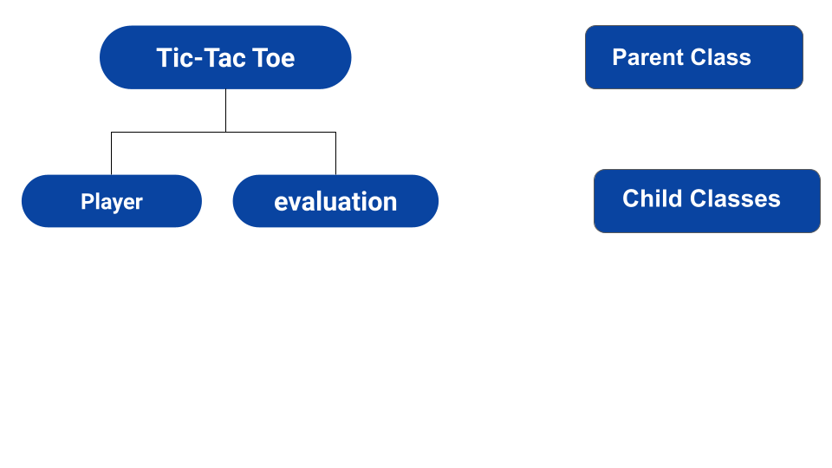


Slide 3
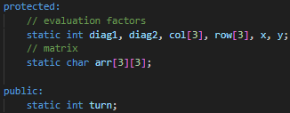
TicTac-Toe Class (base class)
Tic Tac Toe class is the base class /parent class that contains the main matrix in which the game is played as well as the evaluation parameters that are later used to evaluate the win,loss,or draw conditions. it also keeps track of number of turns in the game. all of the variables are static so that they can be accessed by other classes but not updated.

Slide 4
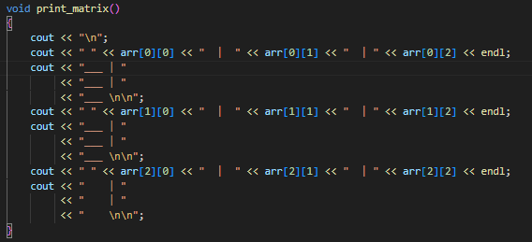
This class also contain 2 important functions
Print_matrix funtion - As the name suggests its the function that is used to print the tic tac toe pattern on the console after each turn.

Slide 5
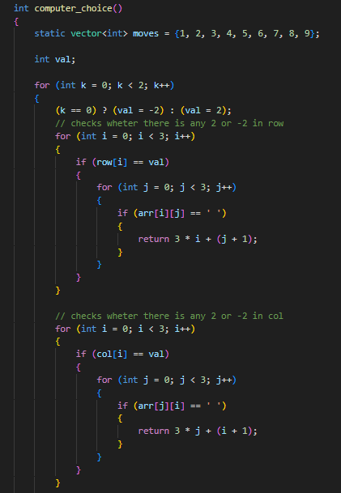
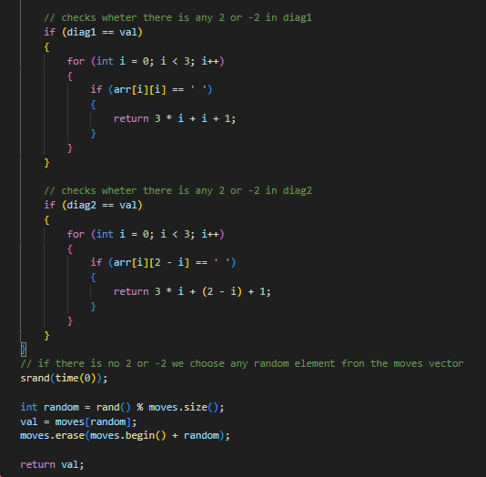
2. Computer_choice - this function is utilised when the player plays in 1 player mode. this functons makes a move on its own in a random manner and on the basis of current game position.

Slide 6
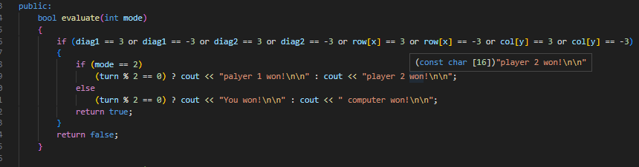
Evaluation class (child class)
this class is one of the 2 child classes . it inherits the Tic Tac Toe class privately thus is capable of accesing the matrix as well as the evalutaion favtors present in the Tic Tac Toe class.
there are 2 functions in the class -
evaluate - this funciton is resposible for evealuating the current possition in tjhe matrix and return true if anybody wins or not. it takes 1 input that signifies whether its 1 player mode or 2 palyer mode.

Slide 7
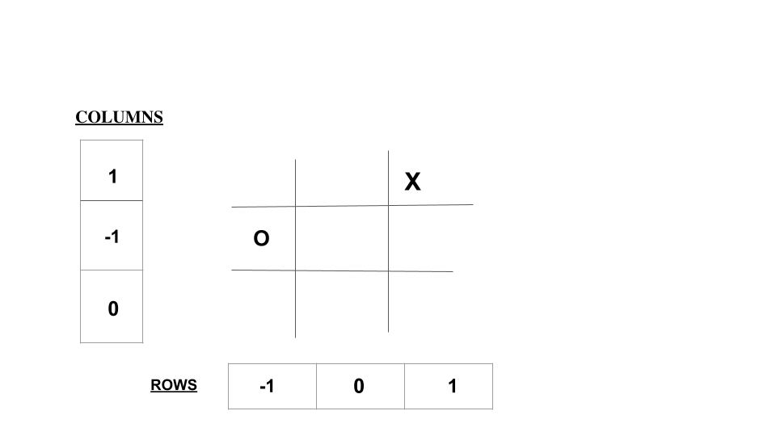
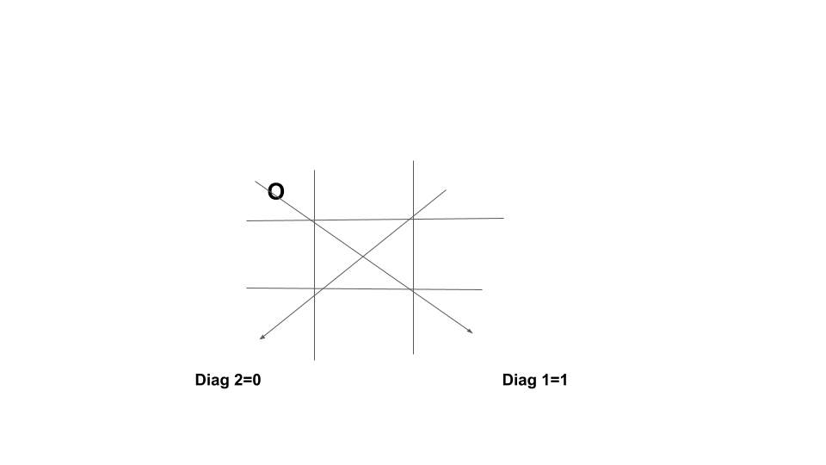

Slide 8
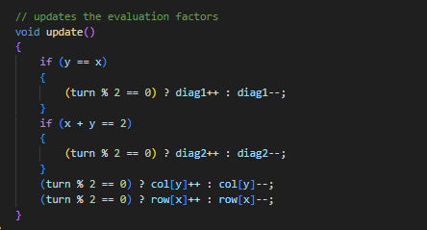
2. update - this function updates all the evaliation factors accodingly.

Slide 9

Player class (Child class)
Like the other class it also privately inherits the Tic Tac Toe class to get access to the matrix.
player class have a private variable named symbol that stores the sybmol that belong to a particular player (mainly X and O).
this class contains 2 functions
set symbol - this sets the symbol variable.

Slide 10
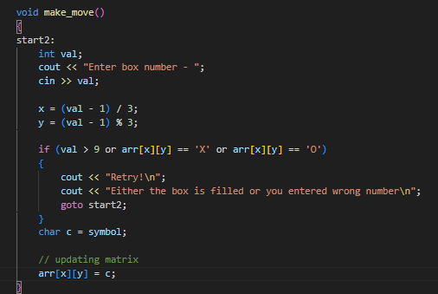
2. make_move - there are 2 make move functions.
1st make_move function donot take any input and it is called when the game is played in 2 player mode.

Slide 11
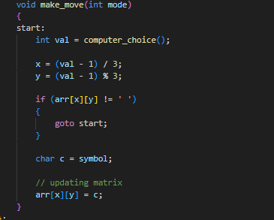
2nd make_move function take one input and it is called when the game is played in 1 player mode.

Slide 12

Objects
In the main function we create the following objects
game - contains the main matrix,evaluation factors and to keep track of number of turns in the game.
p1,p2 are the 2 palyers
eval object is used to call update and evaluate function during the game
Times New Roman
Times New Roman
Times New Roman

Slide 13
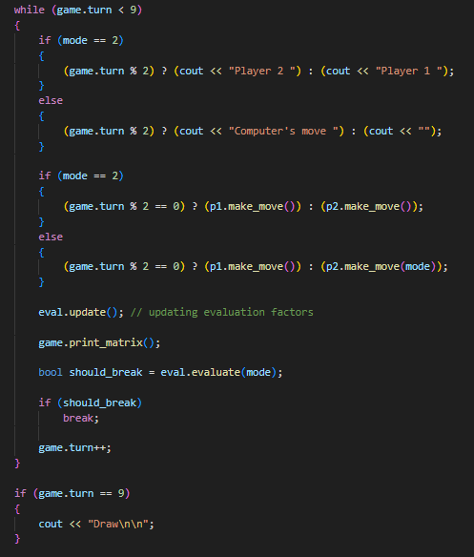

Game loop

